Slide 2
Outline:
History of Computer.
What is Quantum Computer ?
Why Quantum Computer ?
How Quantum Computer works?
What can Quantum Computer do?
Summary.

Slide 3
History of Computer :
There are totally five Generations of Computer till now. Initially Generation term is used to distinguish between varying hardware technology. But nowadays include Hardware and Software.
Following are five main generation of computers:

Slide 4
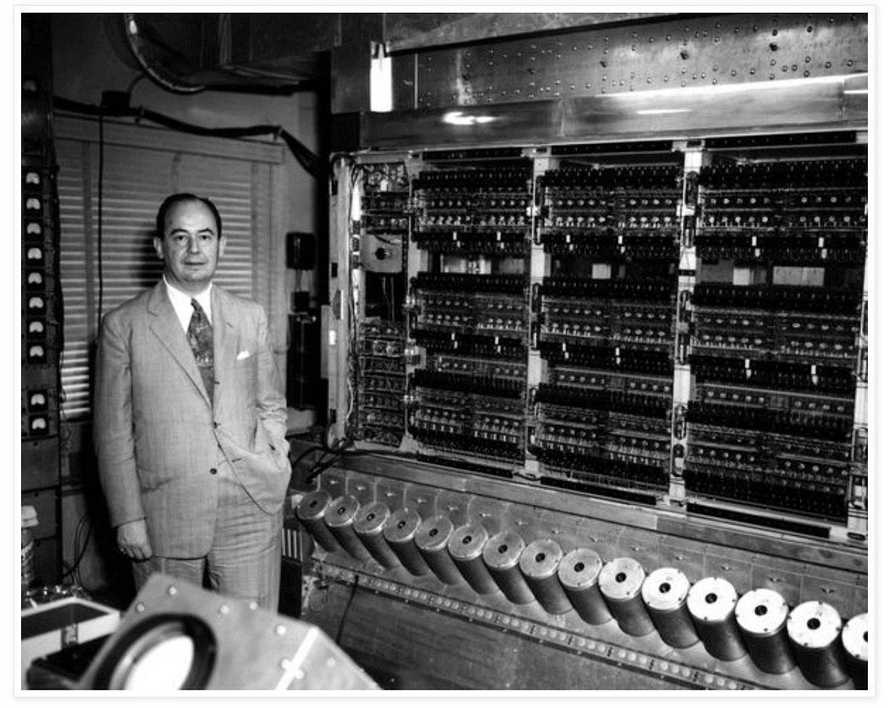
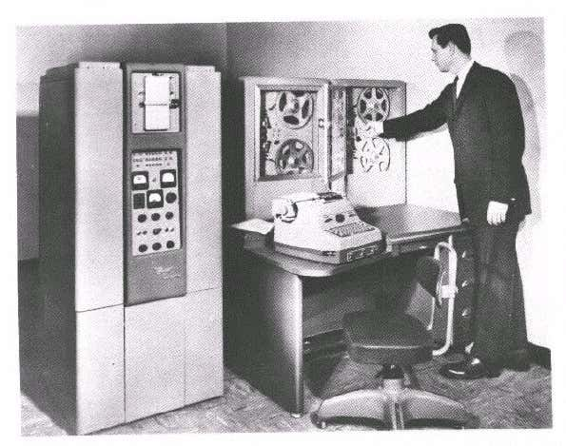
Computer generation

Slide 5
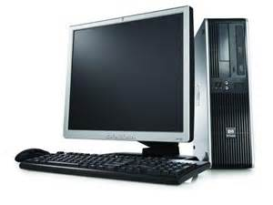
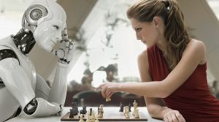
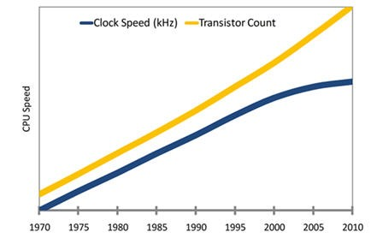
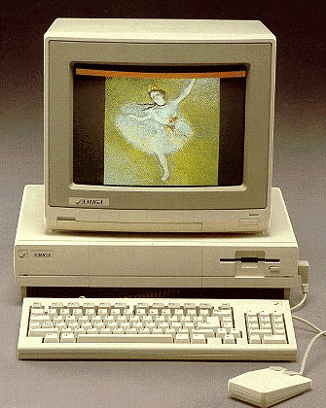

Slide 6
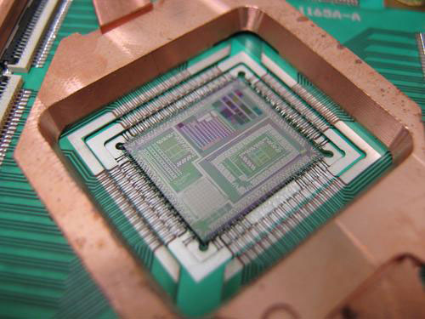
Quantum Computer :
A quantum computer is a machine that performs calculations based on the laws of quantum mechanics, which is the behavior of particles at the sub-atomic level.

Slide 7
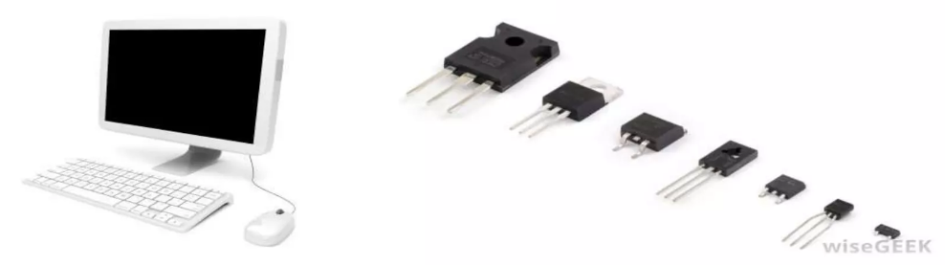
Classical Computer :
A computer that uses voltages flowing through circuits and gates, which use principle of Digital electronics to perform operation

Slide 8
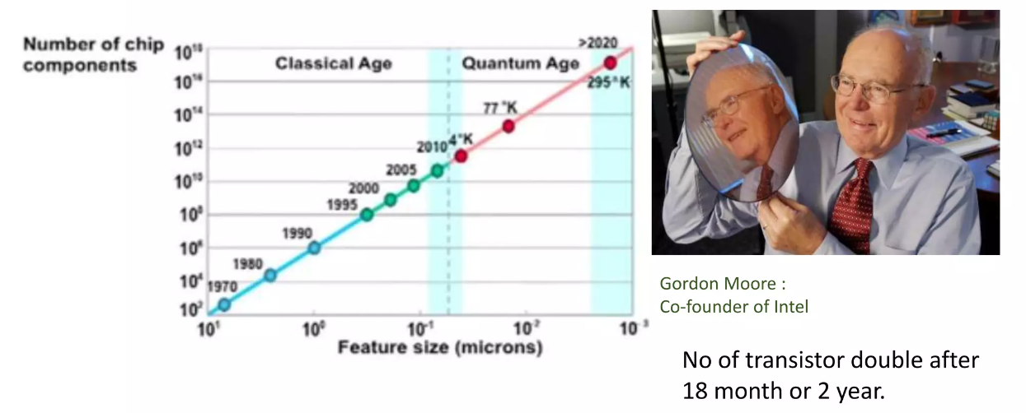
Moore's Law to the Atomic-scale

Slide 9
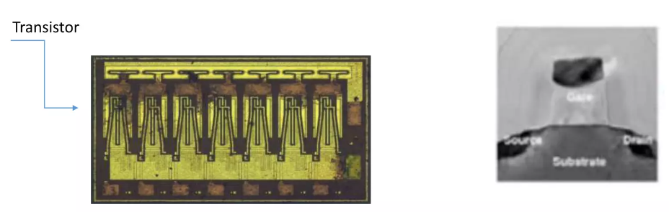
Classical bits :
In the classical computer every thing is decoded in binary number and these two binary bits are called Classical bits. Classical computer use these bits as combination and perform the desired result.
We know that a single chip made of large no of transistor and all this transistor must work reliably so that our computer/mobile/machine(based on binary bit) can work properly.

Slide 10
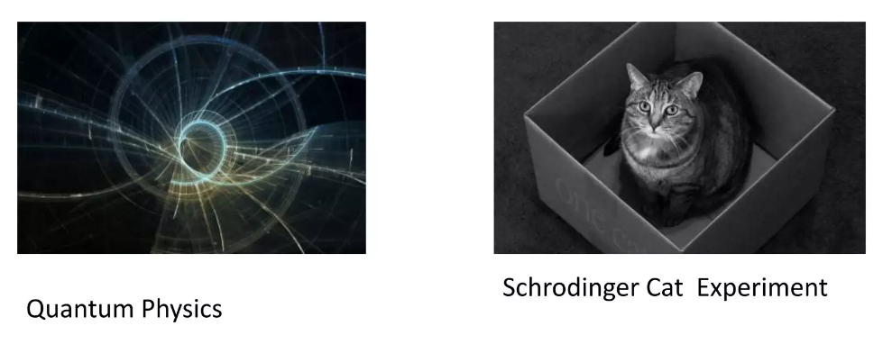
Quantum bits :
Quantum Physics (Quantum theory) is fundamental branch of Physics which describe physical phenomena at atomic or sub-atomic scale. Quantum mechanics provides an extremely accurate description of the behaviour of photons, electrons and other atomic and molecular-scale objects or sometime it is called reality.

Slide 11
Essential Elements of Quantum Physics
Particles are waves, and vice versa
Quantum physics tells us that every object in the universe has both particle like and wave-like properties.
Quantum states are discrete
The "quantum" in quantum physics refers to the fact that everything in quantum physics comes in discrete amounts.
Well defined Spin
All the Quantum Element (electron, proton, neutron)have a well defined spin .Actually they have momentum and Orientation in space.
Measurement determines reality
After a measurement is made, the state of the particle is absolutely determined.
Quantum physics is not magic
The bedrock principles of physics are still intact: energy is still conserved, entropy still increases, nothing can move faster than the speed of light.

Slide 12
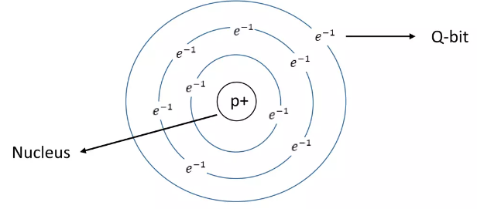
Quantum bits:
As we know that to perform operation we must need binary bits or something equivalent to binary bits.
By using Q-bits we can do similar operation as classical computer. Quantum computer use Quantum object to perform operation. We can either can use a electron/proton as Q-bit. But it is very difficult to do operation with proton because proton reside in nucleus. Electron of any material can be use as Q-bit

Slide 13


Quantum bits:

Slide 14
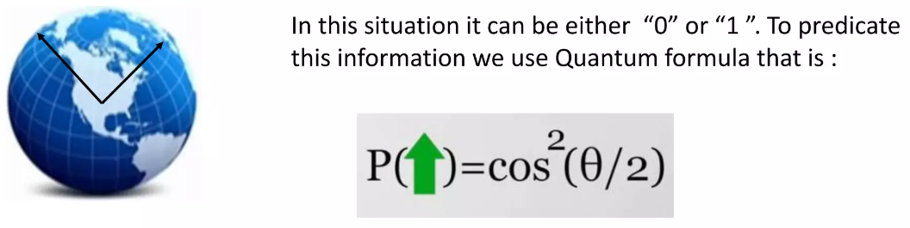
Quantum bits:

Slide 15
How Quantum Computer works
A Quantum computer use the principle of Quantum physics. Like as classical computer's binary bits, in quantum Computer we use Q-bits. So now to understand that how Quantum computer works we need to manipulate these Q-bits.
Quantum computers promise to do computation more powerfully than classical computers due to the ability of a quantum computer to be in some states that have no equivalence in a classical computer such as a superposition of values and/or an entanglement between some particles of a quantum system.
Main building blocks of Quantum computer is :
Q-bits
Superposition
Entanglement

Slide 16
Superposition
Superposition is a principle of Quantum physics that describe a challenging concept about the nature and behaviour of matter at atomic level. Principle of super- position states that while we don't know what is the state of any Q-bit, actually it is all the possible state simultaneously, as long as we don't measure it. Think of a qubit as an electron in a magnetic field. The electron's spin may be either in alignment with the field, which is known as a spin-up state, or opposite to the field, which is known as a spin-down state. Changing the electron's spin from one state to another is achieved by using a pulse of energy, such as from a laser. But what if give half of the energy to total energy to change the spin of electron?

Slide 17
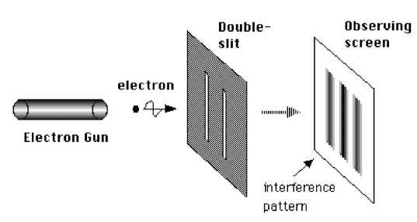
Superposition
By using this property we can do parallel processing, Classical computers today, even so called parallel processors, truly they still do one task at a time. But their time to do one task is so small that we can't feel it and its seems as parallel processing.
We can proof Superposition theorem with Double slit Experiment over Schrodinger's cat Experiment

Slide 18
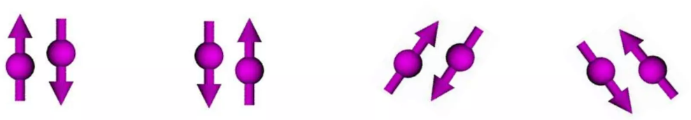
Entanglement
Particles (such as photons, electrons, or q-bits) that have interacted at some point retain a type of connection and can be entangled with each other in pairs, in process known as correlation. Knowing the spin state of one entangled particle up or down allows one to know that the spin of its mate is in the opposite direction and this is known as Entanglement.
Quantum entanglement allows qubits that are separated by incredible distances to interact with each other instantaneously (not limited to the speed of light). Taken together, quantum superposition and entanglement create an enormously enhanced computing power.

Slide 19
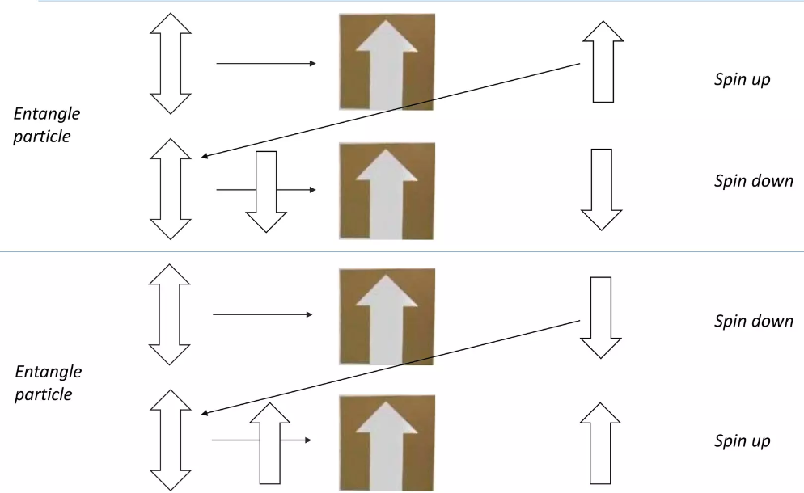
Entanglement - spooky reaction

Slide 20
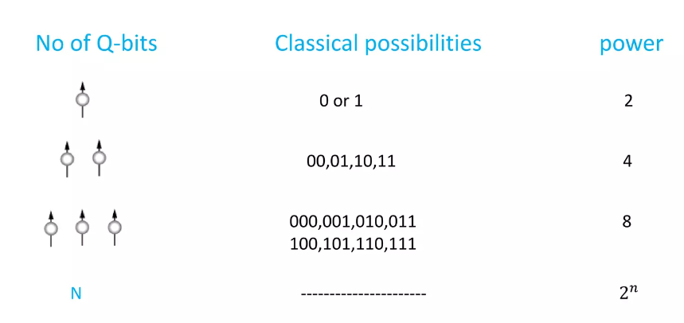
Power of Q-bits
A 100 Q-bit quantum computer is more power full than a super computer....
A Quantum computer with 500 Q-bits is more power full than all the computer of world connect together.

Slide 21
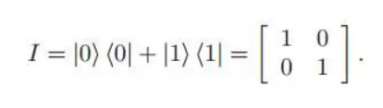
Representation of Q-bits/states
States can be represented via either the vector/matrix notation, or Dirac Notation. Dirac Notation is more useful for describing the quantum states and the evolution of the state of the system
Dirac notation:
1. ψ>: denotes a column vector that represents a quantum state.
2. <ψ: denotes a row vector that represents the dual of 1, i.e. the complex conjugate transpose

Slide 22
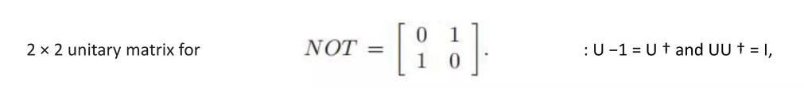
Quantum Gates
Quantum Gates are same as classical Gates (AND, OR, NOT, XOR. etc.) but with a little change that is we use Quantum vector/matrix instead of classical transistor. although Quantum gates do the same functional operation. Quantum gates used during the computation must follow the fundamental laws of quantum physics. To satisfy this condition, using any matrix U as a quantum gate, it must be unitary.

Slide 23
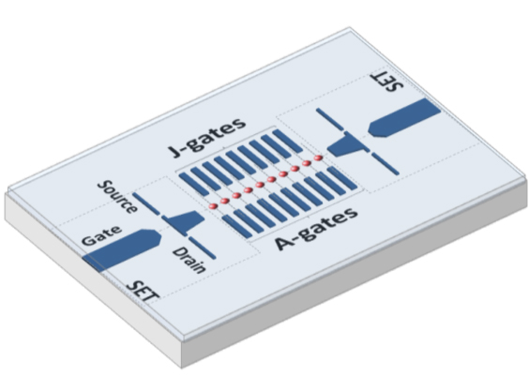
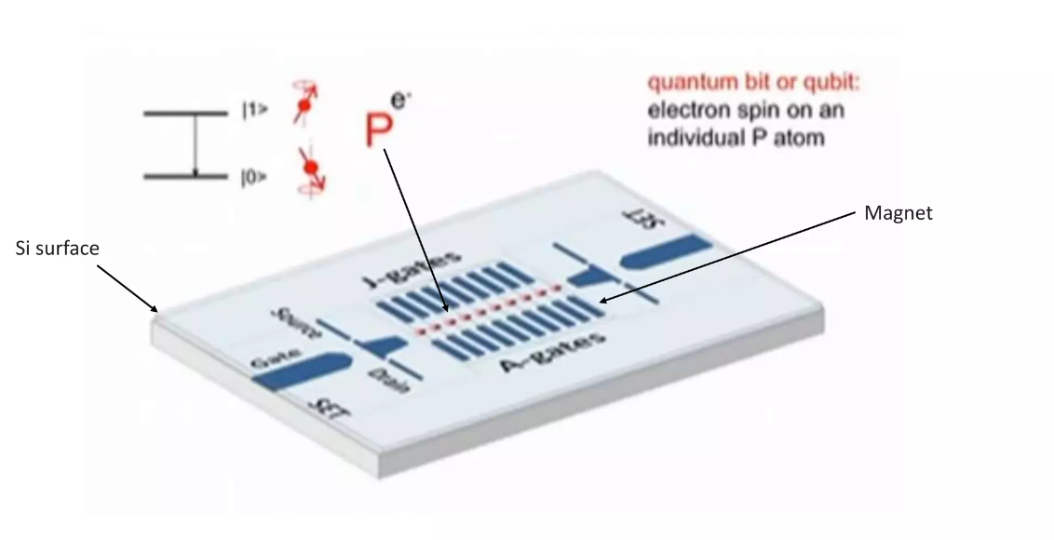
Quantum Architecture

Slide 24
What can Quantum Computer do?
Application:
Factorisation (data security)
Physical modelling (climate, economic, engineering)
Simulation (chemistry, material)
Data bases searching (bioinformatics)

Slide 25
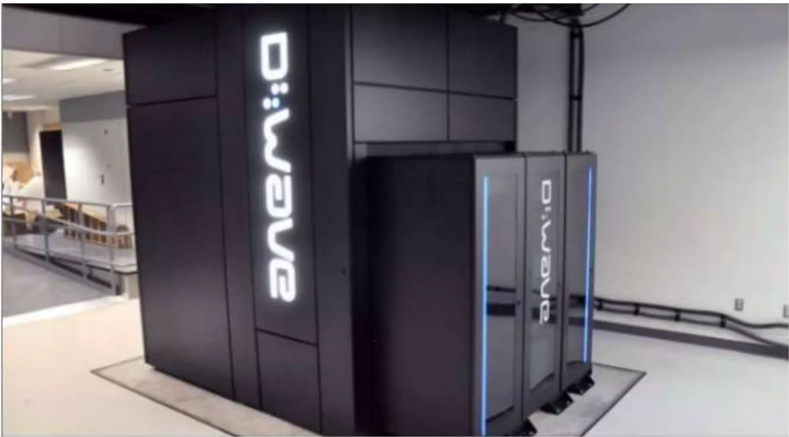
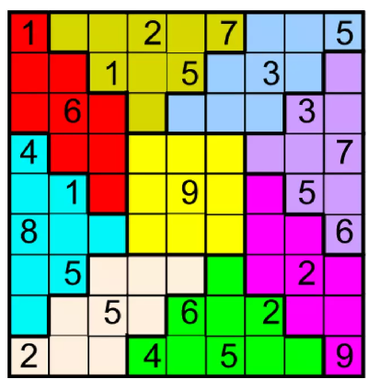
Abacus of Quantum computer
Canadian start up company D-wave demonstrate a 30 Q-bit Quantum computer. The Computer solve the Sudoku puzzle and other pattern matching problems.

Slide 26
Summary:
➤ A quantum computer is a machine that performs calculations based on the laws of quantum mechanics, which is the behavior of particles at the sub-atomic level.
➤ David J Wineland And Serge Haroche were Awarded with the Nobel Prize for their work regarding measurement and manipulation of individual Quantum Systems in 2012.
Quantum computer use Q-bits to do operation. Electron, proton can be use as Q- bits.
Superposition and Entanglement are main building block of Quantum computing and these property speed up Quantum computer exponentially.
➤ Every time we add a Q-bit we double the computation power of Quantum computer.

